Slide 1
Two-way ANOVA——Amputee data（two）

Slide 2
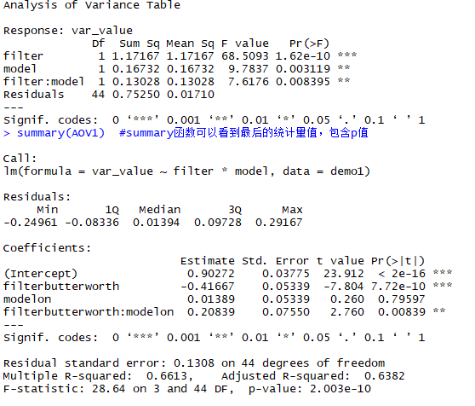
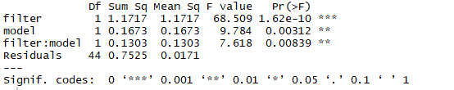
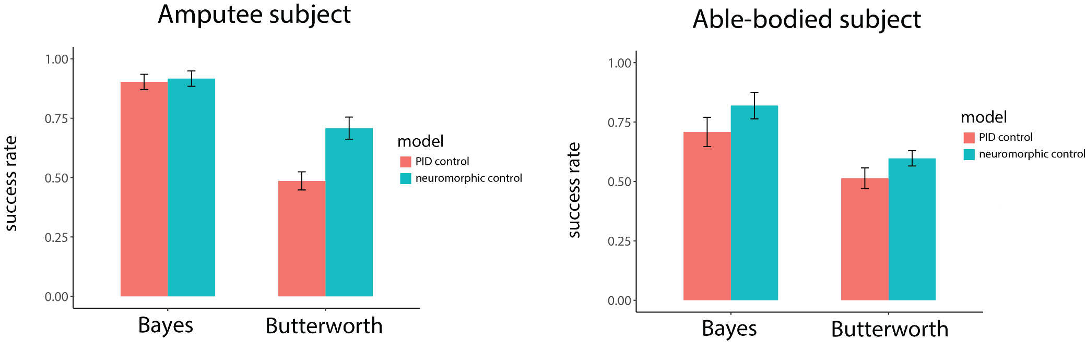
Success rate——Amputee
利用lm, anova
利用aov
filter—F(1,44)=68.5093, P<0.001
filter—F(1,44)=68.509, P<0.001
model—F(1,44)=9.7837, P<0.01
model—F(1,44)=9.784, P<0.01
filter: model —F(1,44)=7.6176, P<0.01
filter: model —F(1,44)=7.618, P<0.01

Slide 3
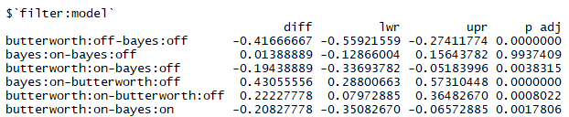
SR — post hoc test

Slide 4
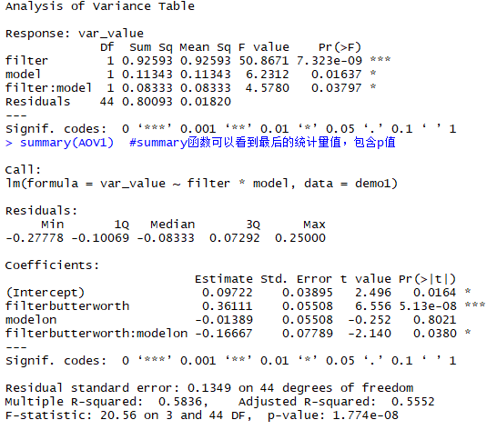
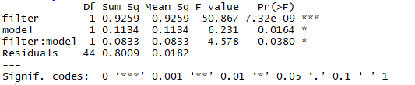
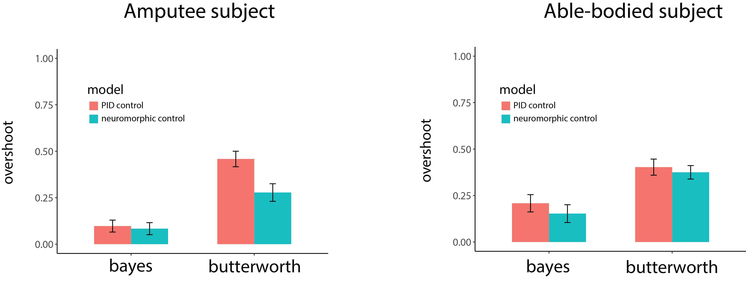
Break rate ——Amputee
利用aov
filter: F(1,44)=50.8671, P<0.001
filter—F(1,44)=50.867, P<0.001
利用lm, anova
model: F(1,44)=6.2312, P<0.05
model—F(1,44)=6.231, P<0.05
filter: model —F(1,44)=4.5780, P<0.05
filter: model —F(1,44)=4.578, P<0.05
Bayes Butterworth

Slide 5
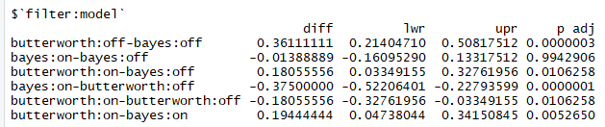
BR — post hoc test
Bayes Butterworth

Slide 6
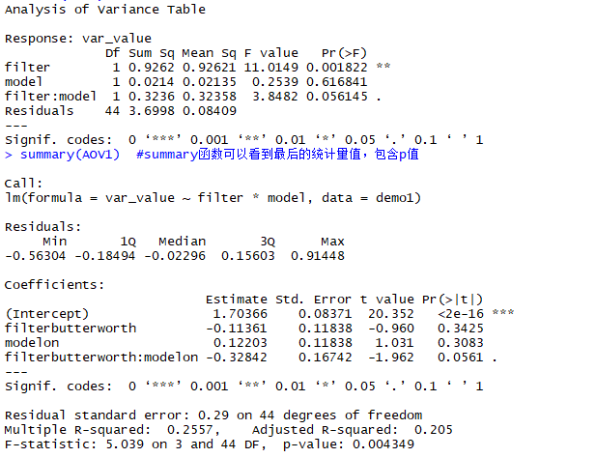
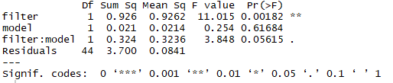
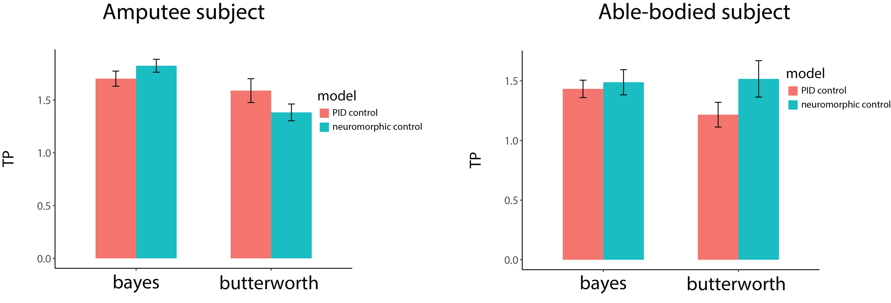
Throughput ——Amputee
利用aov
filter—F(1,44)=11.0149, P<0.01
filter—F(1,44)=11.015, P<0.01
利用lm, anova
mode—F(1,44)=0.2539, P=0.616841
mode—F(1,44)=0.254, P=0.61684
filter: model —F(1,44)=3.8482, P=0.056145
filter: model —F(1,44)=3.848, P=0.05615
Bayes Butterworth

Slide 7
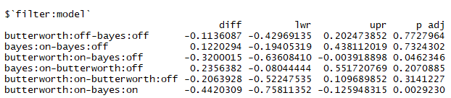
TP — post hoc test
Bayes Butterworth

